Slide 1
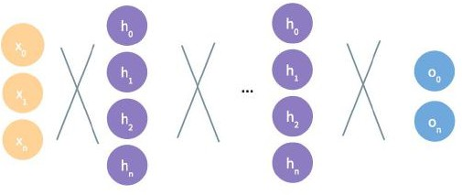


Intro to Deep Learning
Kheireddin Kadri

Slide 2
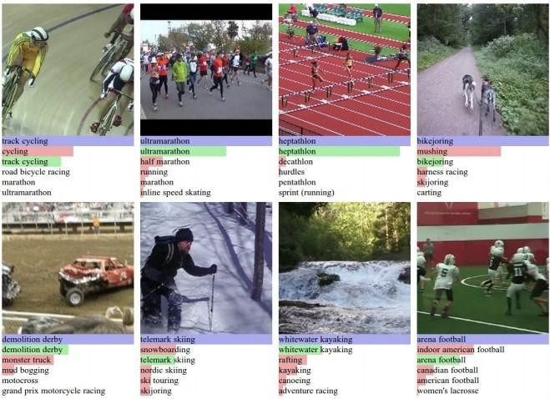
Deep Learning Success
- Image Classification Machine Translation Speech Recognition Speech Synthesis Game Playing
… and many, many more

Slide 3
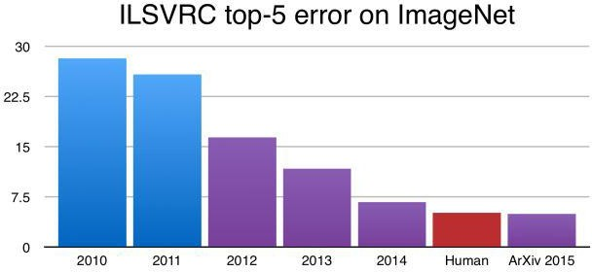
Deep Learning Success
- Image Classification Machine Translation Speech Recognition Speech Synthesis Game Playing
AlexNet
Krizhevsky, Sutskever, Hinton 2012
Better than humans
… and many, many more

Slide 4

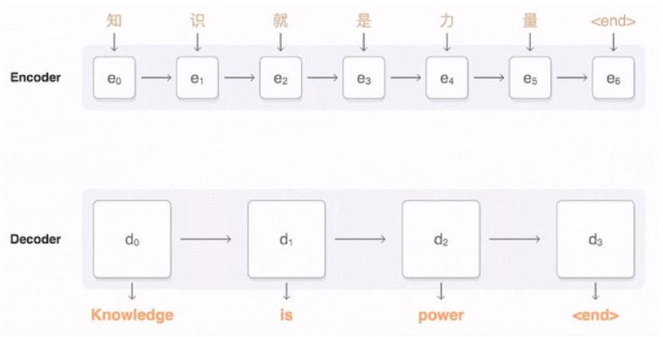
Deep Learning Success
Image Classification
- Machine Translation Speech Recognition Speech Synthesis Game Playing
.
… and many, many more

Slide 5
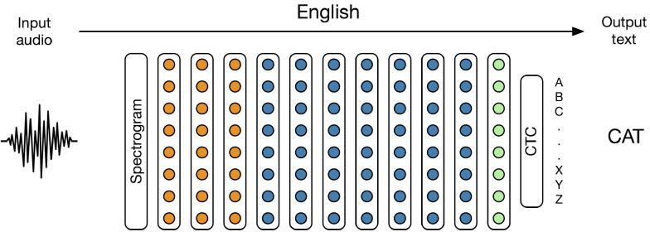
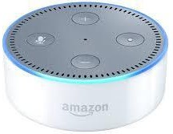

Deep Learning Success
Image Classification Machine Translation
- Speech Recognition Speech Synthesis Game Playing
.
… and many, many more

Slide 6
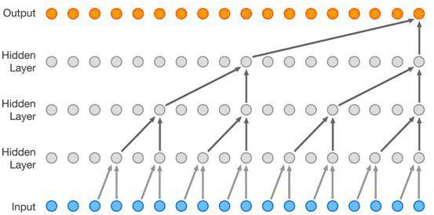
Deep Learning Success
Image Classification Machine Translation Speech Recognition
- Speech Synthesis
Game Playing
.
… and many, many more

Slide 7
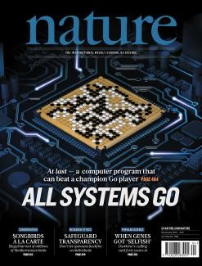
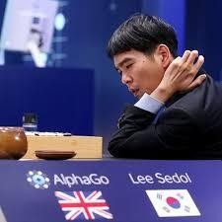
Deep Learning Success
Image Classification Machine Translation Speech Recognition Speech Synthesis
- Game Playing
.
… and many, many more

Slide 8
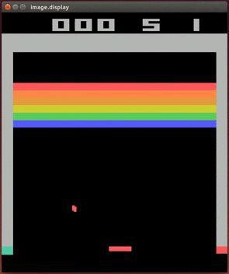
Deep Learning Success
Image Classification Machine Translation Speech Recognition Speech Synthesis
- Game Playing
.
… and many, many more

Slide 9
Goals
Fundamentals
Practical skills
Up to speed on current state of the field
Knowledge, intuition, know-how, and community to do deep learning research and development.

Slide 10
Why Deep Learning and why now?

Slide 11
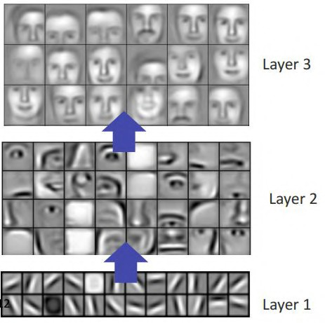
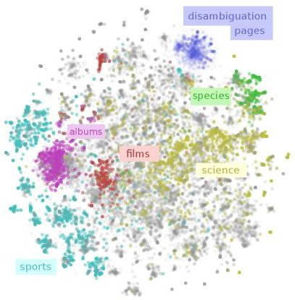
Why Deep Learning?
Hand-Engineered Features vs. Learned features

Slide 12



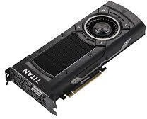
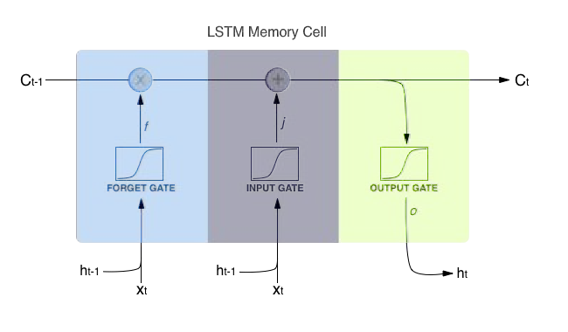
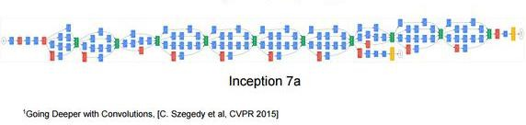
Why Now?
Large Datasets
GPU Hardware Advances + Price Decreases
Improved Techniques

Slide 13
Fundamentals of Deep Learning

Slide 14
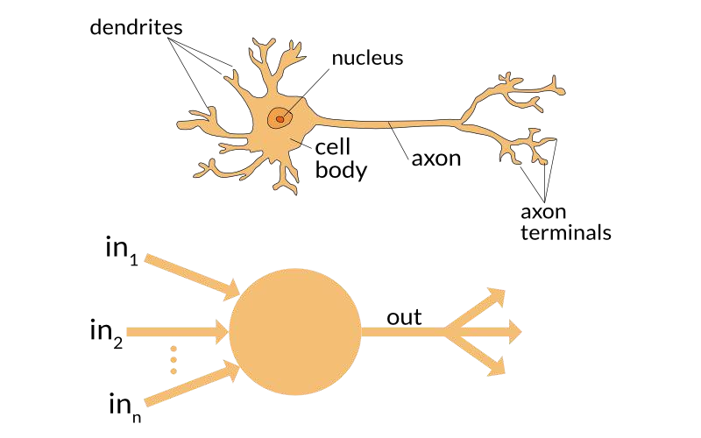
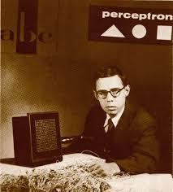
The Perceptron
Invented in 1954 by Frank Rosenblatt
Inspired by neurobiology

Slide 15
The Perceptron
inputs
weights
sum
non-linearity
x₀
x₁
w
0
w
1
w₂
x₂
>
w
n
x_{n}
1
bias
b

Slide 16

Perceptron Forward Pass
inputs
weights
sum
non-linearity
x₀
x₁
w
0
w
1
w₂
output
x₂
>
w
n
x_{n}
1
b
bias

Slide 17
Perceptron Forward Pass
inputs
weights
sum
non-linearity
x₀
x₁
w
0
w
1
w₂
output
x₂
>
w
n
x_{n}
1
b
bias

Slide 18
Perceptron Forward Pass
inputs
weights
sum
non-linearity
x₀
x₁
w
0
w
1
w₂
output
x₂
>
w
n
x_{n}
1
b
bias

Slide 19
Perceptron Forward Pass
inputs
weights
sum
non-linearity
x₀
x₁
w
0
w
1
w₂
output
x₂
>
w
n
x_{n}
1
b
bias

Slide 20

Perceptron Forward Pass
inputs
weights
sum
non-linearity
x₀
x₁
w
0
w
1
w₂
output
x₂
>
w
n
x_{n}
1
b
bias

Slide 21
Perceptron Forward Pass
inputs
weights
sum
non-linearity
Activation Function
x₀
x₁
w
0
w
1
w₂
output
x₂
>
w
n
x_{n}
1
b
bias

Slide 22


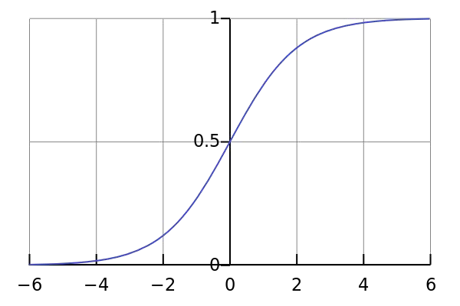
Sigmoid Activation
inputs
weights
sum
non-linearity
x₀
x₁
w
0
w
1
w₂
output
x₂
>
w
n
x_{n}
1
b
bias

Slide 23
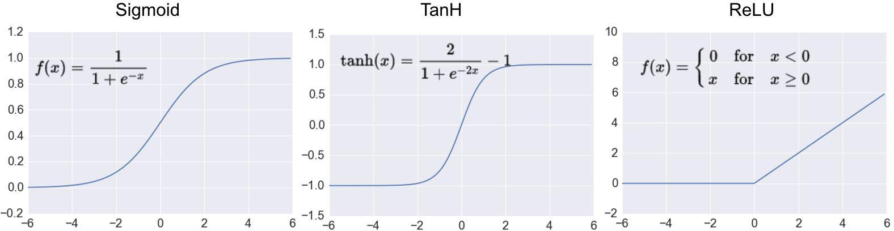
Common Activation Functions

Slide 24
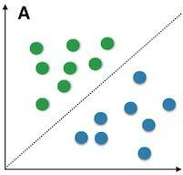
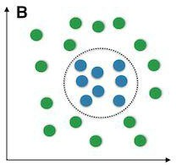
Importance of Activation Functions
Activation functions add non-linearity to our network’s function
Most real-world problems + data are non-linear

Slide 25
Perceptron Forward Pass
inputs
weights
sum
non-linearity
2
3
0.1
0.5
2.5
output
-1
>
0.2
5
1
bias
3.0

Slide 26
Perceptron Forward Pass
inputs
weights
sum
non-linearity
(2*0.1) +
2
0.1
(3*0.5) +
3
0.5
2.5
output
(-1*2.5) +
-1
>
0.2
(5*0.2) +
5
3.0
(1*3.0)
1
)
bias

Slide 27


Perceptron Forward Pass
inputs
weights
sum
non-linearity
2
3
0.1
0.5
2.5
output
-1
>
0.2
5
1
3.0
bias

Slide 28
How do we build neural networks with perceptrons?

Slide 29
Perceptron Diagram Simplified
inputs
weights
sum
non-linearity
x₀
x₁
w
0
w
1
w₂
output
x₂
>
w
n
x_{n}
1
b
bias

Slide 30
Perceptron Diagram Simplified
inputs
output
x₀
x₁
o₀
x₂
x_{n}

Slide 31
Multi-Output Perceptron
Input layer
output layer
x₀
x₁
o₀
x₂
o₁
x_{n}

Slide 32
Multi-Layer Perceptron (MLP)
input layer
hidden layer
output layer
h₀
x₀
h₁
o₀
x₁
h₂
o_{n}
x_{n}
h_{n}

Slide 33
Multi-Layer Perceptron (MLP)
input layer
hidden layer
output layer
h₀
x₀
h₁
o₀
x₁
h₂
o_{n}
x_{n}
h_{n}

Slide 34
Deep Neural Network
Input layer
hidden layers
output layer
h₀
h₀
x₀
h₁
h₁
o₀
x₁
...
h₂
h₂
o_{n}
x_{n}
h_{n}
h_{n}

Slide 35
Applying Neural Networks

Slide 36
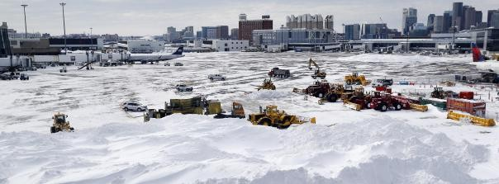

Example Problem: Will my Flight be Delayed?

Slide 37
Example Problem: Will my Flight be Delayed?
Temperature: -20 F
Wind Speed: 45 mph

Slide 38
Example Problem: Will my Flight be Delayed?
[-20, 45]

Slide 39
Example Problem: Will my Flight be Delayed?
h₀
x₀
[-20, 45]
h₁
o₀
x₁
h₂

Slide 40
Example Problem: Will my Flight be Delayed?
h₀
x₀
Predicted: 0.05
[-20, 45]
h
o
1
0
x₁
h₂

Slide 41
Example Problem: Will my Flight be Delayed?
h₀
x₀
Predicted: 0.05
Actual: 1
[-20, 45]
h
o
1
0
x₁
h₂

Slide 42

Quantifying Loss
h₀
x₀
Predicted: 0.05
Actual: 1
[-20, 45]
h
o
1
0
x₁
h₂
Predicted
Actual

Slide 43
Total Loss
Input
[
[-20, 45],
[80, 0],
[4, 15],
[45, 60],
]
Predicted
Actual
h₀
x₀
[ | [
0.05 | 1
0.02 | 0
0.96 | 1
0.35 | 1
] | ]
h
o
1
0
x₁
h₂
Predicted
Actual

Slide 44
Total Loss
Input
[
[-20, 45],
[80, 0],
[4, 15],
[45, 60],
]
Predicted Actual
[ [
h₀
x₀
0.05
1
h
o
1
0
0.02 0
x₁
0.96 1
h₂
0.35
1
]
]
Predicted
Actual

Slide 45
Binary Cross Entropy Loss
Input
[
[-20, 45],
[80, 0],
[4, 15],
[45, 60],
]
Predicted Actual
[ [
h₀
x₀
0.05
1
h
o
1
0
0.02 0
x₁
0.96 1
h₂
0.35
1
]
]
Actual
Predicted
Actual
Predicted

Slide 46

Mean Squared Error (MSE) Loss
Input
[
[-20, 45],
[80, 0],
[4, 15],
[45, 60],
]
Predicted Actual
[ [
h₀
x₀
10
40
h
o
1
0
45 42
x₁
100 110
h₂
15
55
]
]
Predicted
Actual

Slide 47
Training Neural Networks

Slide 48

Training Neural Networks: Objective

Slide 49


Training Neural Networks: Objective
loss function

Slide 50
Training Neural Networks: Objective

Slide 51
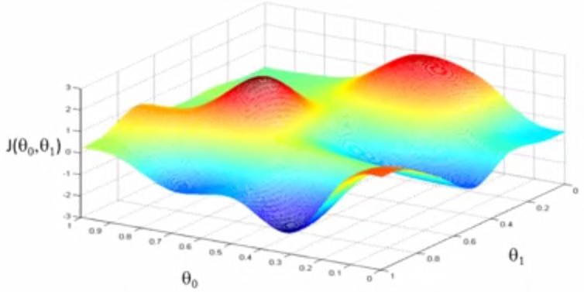
Loss is a function of the model’s parameters

Slide 52

How to minimize loss?
Start at random point
+

Slide 53

How to minimize loss?
Compute:
+

Slide 54

How to minimize loss?
Move in direction opposite of gradient to new point
+

Slide 55
How to minimize loss?
Move in direction opposite of gradient to new point
+
+

Slide 56
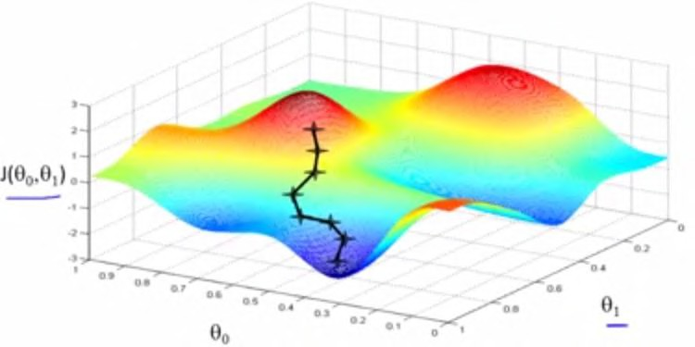
How to minimize loss?
Repeat!

Slide 57
This is called Stochastic Gradient Descent (SGD)
Repeat!

Slide 58
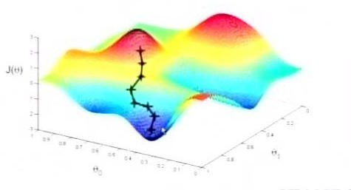

Stochastic Gradient Descent (SGD)
Initialize θ randomly
For N Epochs
For each training example (x, y):
Compute Loss Gradient:
Update θ with update rule:

Slide 59
Stochastic Gradient Descent (SGD)
Initialize θ randomly
For N Epochs
For each training example (x, y):
Compute Loss Gradient:
Update θ with update rule:

Slide 60
Stochastic Gradient Descent (SGD)
Initialize θ randomly
For N Epochs
For each training example (x, y):
Compute Loss Gradient:
Update θ with update rule:
How to Compute Gradient?

Slide 61
Calculating the Gradient: Backpropagation
W₁
W₂
x₀
h₀
o₀
J(Ө)

Slide 62

Calculating the Gradient: Backpropagation
W₁
W₂
x₀
h₀
o₀
J(Ө)

Slide 63
Calculating the Gradient: Backpropagation
W₁
W₂
x₀
h₀
o₀
J(Ө)
Apply the chain rule

Slide 64
Calculating the Gradient: Backpropagation
W₁
W₂
x₀
h₀
o₀
J(Ө)
Apply the chain rule

Slide 65

Calculating the Gradient: Backpropagation
W₁
W₂
x₀
h₀
o₀
J(Ө)
Apply the chain rule

Slide 66

Calculating the Gradient: Backpropagation
W₁
W₂
x₀
h₀
o₀
J(Ө)

Slide 67
Calculating the Gradient: Backpropagation
W₁
W₂
x₀
h₀
o₀
J(Ө)
Apply the chain rule

Slide 68
Calculating the Gradient: Backpropagation
W₁
W₂
x₀
h₀
o₀
J(Ө)
Apply the chain rule

Slide 69
Calculating the Gradient: Backpropagation
W₁
W₂
x₀
h₀
o₀
J(Ө)
Apply the chain rule
Apply the chain rule

Slide 70
Calculating the Gradient: Backpropagation
W₁
W₂
x₀
h₀
o₀
J(Ө)
Apply the chain rule
Apply the chain rule

Slide 71
Training Neural Networks In Practice

Slide 72
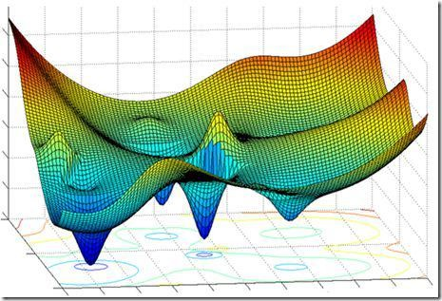
Loss function can be difficult to optimize

Slide 73
Loss function can be difficult to optimize
Update Rule:

Slide 74
Loss function can be difficult to optimize
How to Choose Learning Rate?
Update Rule:

Slide 75
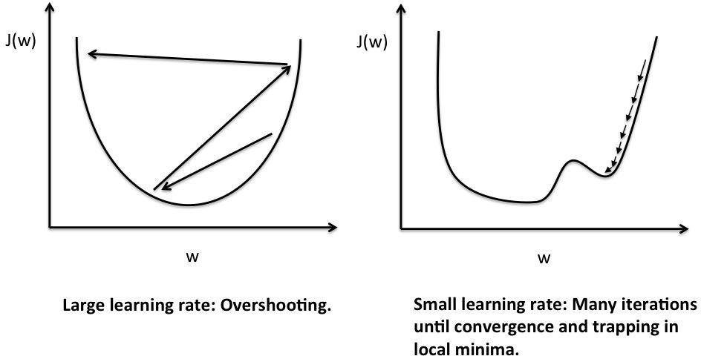
Learning Rate & Optimization
Small Learning Rate

Slide 76
Learning Rate & Optimization
Large learning rate

Slide 77
How to deal with this?
1. Try lots of different learning rates to see what is ‘just right’

Slide 78
How to deal with this?
Try lots of different learning rates to see what is ‘just right’
Do something smarter

Slide 79
How to deal with this?
Try lots of different learning rates to see what is ‘just right’
Do something smarter : Adaptive Learning Rate

Slide 80
Adaptive Learning Rate
Learning rate is no longer fixed
Can be made larger or smaller depending on:
how large gradient is
how fast learning is happening
size of particular weights
etc

Slide 81
Adaptive Learning Rate Algorithms
ADAM
Momentum
NAG
Adagrad
Adadelta
RMSProp
For details: check out http://sebastianruder.com/optimizing-gradient-descent/

Slide 82
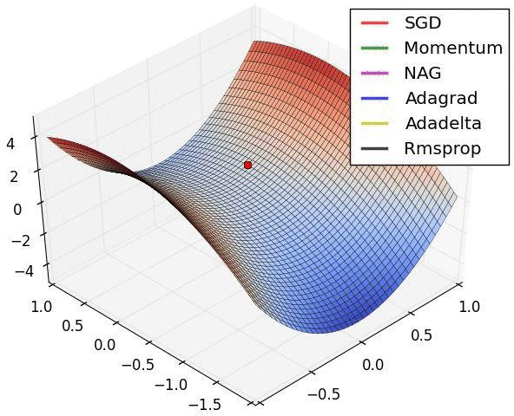
Escaping Saddle Points

Slide 83
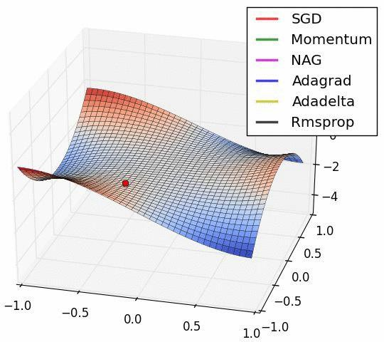
Escaping Saddle Points

Slide 84
Training Neural Networks In Practice 2: MiniBatches

Slide 85
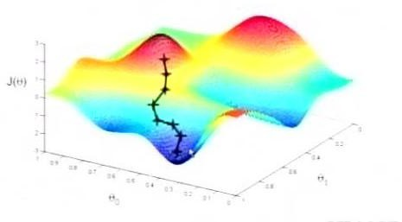
Why is it Stochastic Gradient Descent?
Initialize θ randomly
For N Epochs
Only an estimate of true gradient!
For each training example (x, y):
Compute Loss Gradient:
Update θ with update rule:

Slide 86

Minibatches Reduce Gradient Variance
Initialize θ randomly
For N Epochs
For each training batch {(x0, y0), … , (x_{B}, y_{B})}:
More accurate estimate!
Compute Loss Gradient:
Update θ with update rule:

Slide 87
Advantages of Minibatches
More accurate estimation of gradient
Smoother convergence
Allows for larger learning rates
Minibatches lead to fast training!
Can parallelize computation + achieve significant speed increases on GPU’s

Slide 88
Training Neural Networks In Practice 3: Fighting Overfitting

Slide 89
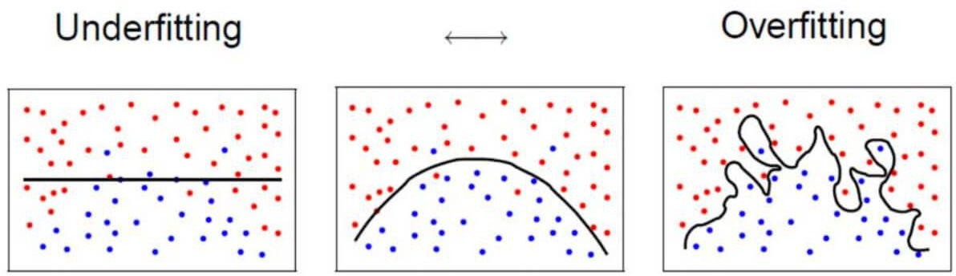
The Problem of Overfitting

Slide 90
Regularization Techniques
Dropout
Early Stopping
Weight Regularization
...many more

Slide 91
Regularization I: Dropout
During training, randomly set some activations to 0
Input layer
hidden layers
output layer
h₀
h₀
x₀
h₁
h₁
o₀
x₁
...
h₂
h₂
o_{n}
x_{n}
h_{n}
h_{n}

Slide 92
Regularization I: Dropout
During training, randomly set some activations to 0
Input layer
hidden layers
output layer
h₀
h₀
x₀
h₁
h₁
o₀
x₁
...
h₂
h₂
o_{n}
x_{n}
h_{n}
h_{n}

Slide 93
Regularization I: Dropout
During training, randomly set some activations to 0
Typically ‘drop’ 50% of activations in layer
Forces network to not rely on any 1 node
Input layer
hidden layers
output layer
h₀
h₀
x₀
h₁
h₁
o₀
x₁
...
h₂
h₂
o_{n}
x_{n}
h_{n}
h_{n}

Slide 94
Regularization I: Dropout
During training, randomly set some activations to 0
Typically ‘drop’ 50% of activations in layer
Forces network to not rely on any 1 node
Input layer
hidden layers
output layer
h₀
h₀
x₀
h₁
h₁
o₀
x₁
...
h₂
h₂
o_{n}
x_{n}
h_{n}
h_{n}

Slide 95
Regularization II: Early Stopping
Don’t give the network time to overfit
...
Epoch 15: Train: 85% Validation: 80%
Epoch 16: Train: 87% Validation: 82%
Epoch 17: Train: 90% Validation: 85%
Epoch 18: Train: 95% Validation: 83%
Epoch 19: Train: 97% Validation: 78%
Epoch 20: Train: 98% Validation: 75%

Slide 96

Regularization II: Early Stopping
Don’t give the network time to overfit
...
Epoch 15: Train: 85% Validation: 80%
Epoch 16: Train: 87% Validation: 82%
Epoch 17: Train: 90% Validation: 85%
Epoch 18: Train: 95% Validation: 83%
Epoch 19: Train: 97% Validation: 78%
Epoch 20: Train: 98% Validation: 75%
Stop here!

Slide 97
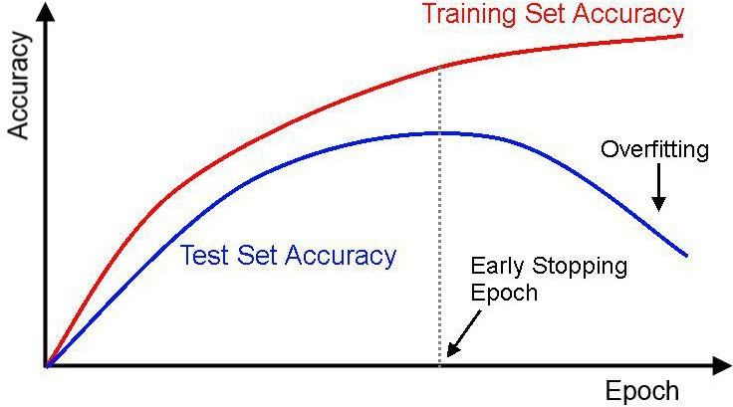

Regularization II: Early Stopping
Stop here!

Slide 98
Regularization III: Weight Regularization
Large weights typically mean model is overfitting
Add the size of the weights to our loss function
Perform well on task + keep weights small

Slide 99

Regularization III: Weight Regularization
Large weights typically mean model is overfitting
Add the size of the weights to our loss function
Perform well on task + keep weights small

Slide 100

Regularization III: Weight Regularization
Large weights typically mean model is overfitting
Add the size of the weights to our loss function
Perform well on task + keep weights small

Slide 101
Regularization III: Weight Regularization
Large weights typically mean model is overfitting
Add the size of the weights to our loss function
Perform well on task + keep weights small

Slide 102
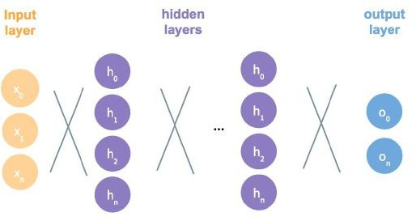
Core Fundamentals Review
Perceptron Classifier
Stacking Perceptrons to form neural networks
How to formulate problems with neural networks
Train neural networks with backpropagation
Techniques for improving training of deep neural networks

Slide 103
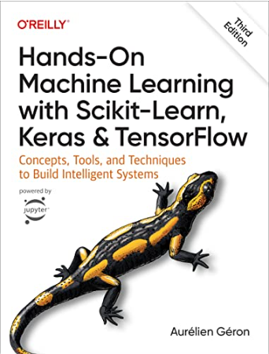
References
Hands on machine learning with scikit learn : Geron aurelien

